Slide 1
Smartphone Tracking App
for Microsoft HoloLens
Team 27
Travis Harbaugh, Ben Holmes, Anthony House, Cory Johannes, Jose Lopez, Ryan Quigley
SDMAY19-27

Slide 2
Task Responsibility and Contributions
Travis Harbaugh
Hololens/Android
Ben Holmes
Android/Bluetooth/Sound
Anthony House & Jose Lopez
Frontend/Backend/Server
Ryan Quigley
Android/Step Tracking
Cory Johannes
Frontend/Research
Advisor:
Daji Qiao
Client:
Andrew Guillemetteette
SDMAY19-27

Slide 3
OVERVIEW
SDMAY19-27

Slide 4
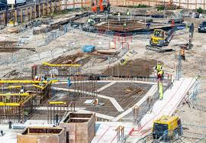
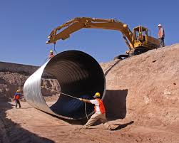
Operating Environment
Dangerous materials/obstacles
Inclement weather
Indoor/Outdoor/Underground
SDMAY19-27

Slide 5
Project Plan Overview
Problem Description
No way of tracking personnel in construction zones
GPS has 3 meter accuracy and interferes with steel, concrete, and other large objects
Project Goals
Create a mobile application track an user position on site.
Create a indoor visualization to allow user tracking within zones of a construction site.
SDMAY19-27

Slide 6
Concept Diagram
SDMAY19-27

Slide 7
REQUIREMENTS
Functional
Non-Functional

Slide 8
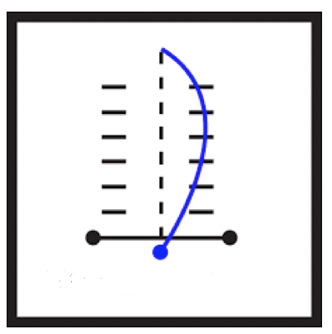
Functional Requirements
Distance Accuracy
1 meter
Moving Sensitive
Walking/Running
Delay accuracy
5 second delay
Display user location in Real Time
SDMAY19-27

Slide 9
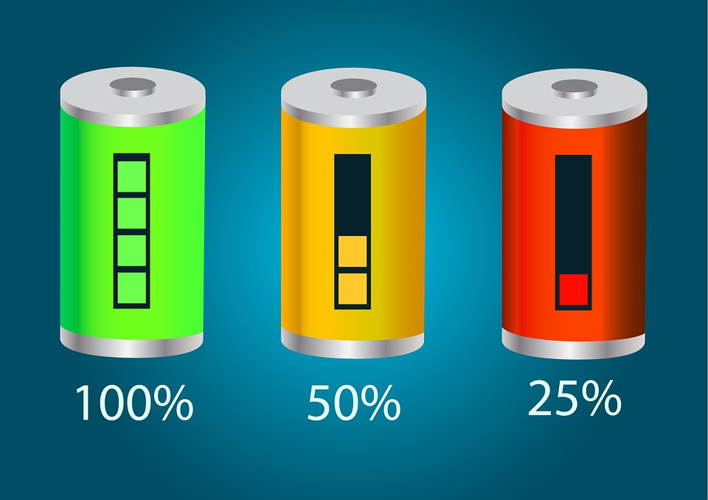
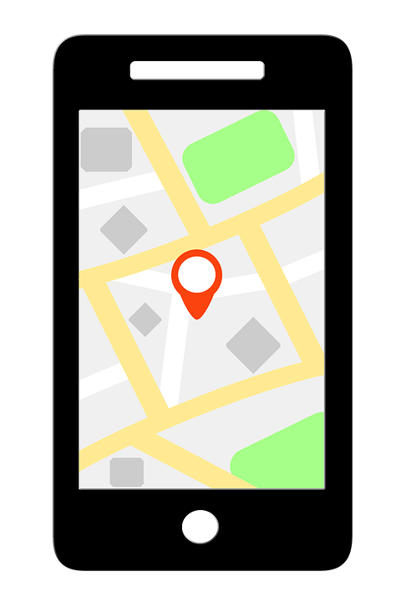
Non-Functional Requirements
Battery Life
Heavy CPU operations
GPS sensor
1 meter accuracy limitation
SDMAY19-27

Slide 10
SYSTEM DESIGN
Hardware & Software
Considerations/Trade-Offs
Architecture

Slide 11
Hardware & Software
Hardware
Android Phones/Tablets
Microsoft Hololens
CentOS Server
Android Software
Android OS
Realm DB
SocketIO
Bluetooth/Sound
Sensor API’s
Hololens Software
Unity
Mapbox SDK
C#
Window 10 pro OS
Server/Client Software
CentOS
NodeJS
RethinkDB
API Endpoints
SocketIO
JavaScript
CSS
HTML5 Canvas
SDMAY19-27

Slide 12
Considerations/Trade-Offs
Server
MongoDB vs RethinkDB
Clients choice
Sockets vs. HTTP
Sockets use TCP
Preserve order
Quicker resolution
HoloLens
Real Time vs. Delayed
RethinkDB vs. MongoDB
Sockets vs. HTTP
Client/Website
Real Time vs. Delayed
Sockets vs. HTTP
Android
Sockets vs. HTTP
Gyroscope vs. Compass
RSSI vs. Sound
TDOA vs. Short distance perimeters
Trilateration vs. Short distance perimeter
Short Distance perimeters
SDMAY19-27
Notes:
One of the trade offs for the hololens is the cost

Slide 13
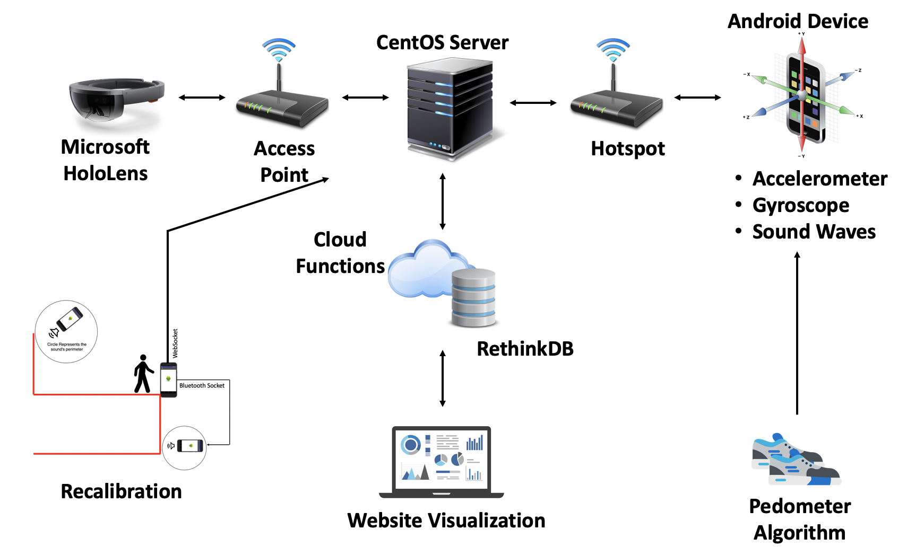
System Design Architecture
Mobile
Android
Backend
CentOS server
Frontend
Microsoft HoloLens
Website
SDMAY19-27

Slide 14
System
Implementation
SDMAY19-27

Slide 15
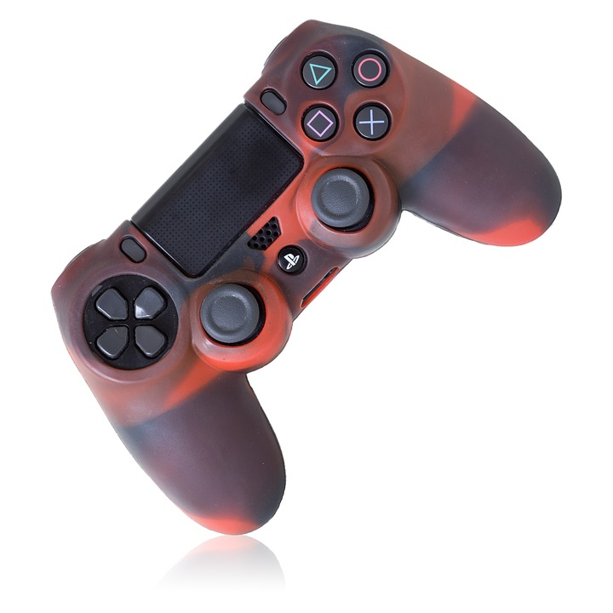
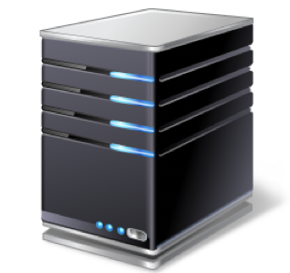
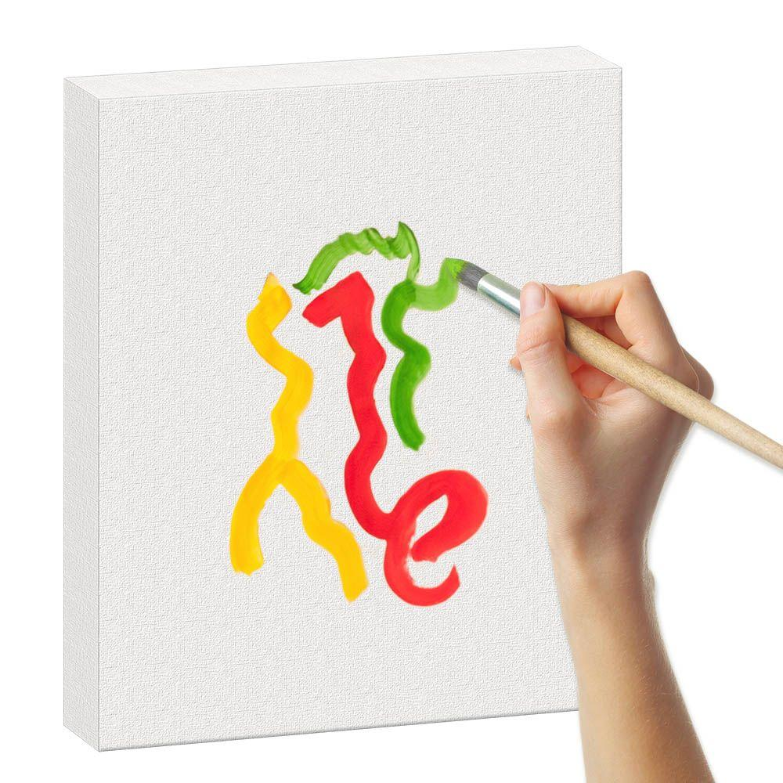
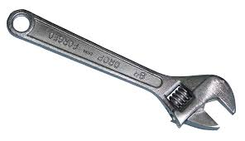
Front-End
CLIENT
SERVER

Slide 16
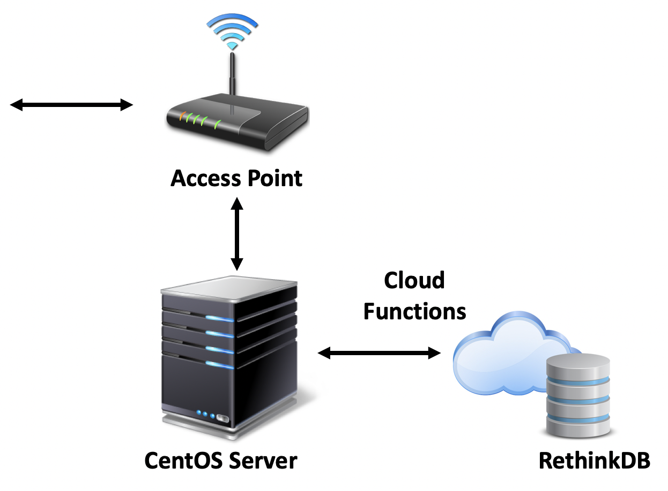
Back-End
CLIENT
SERVER

Slide 17
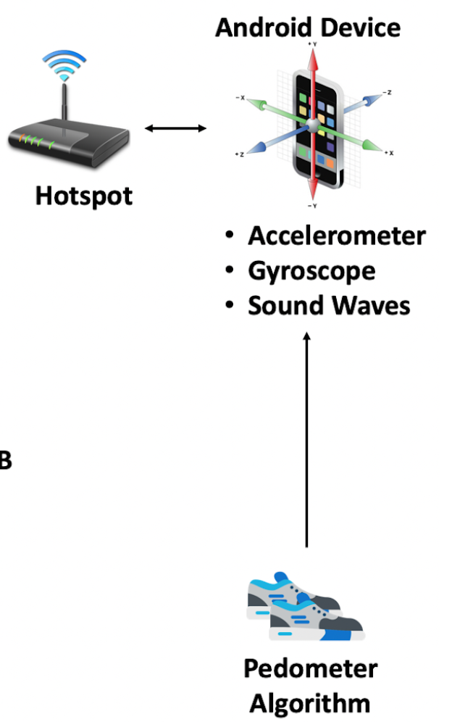
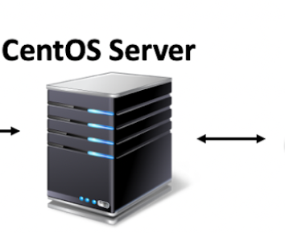
User Step Tracking Implementation
Step Tracking Algorithm
Is acceleration Peaking?
Are we recording?
No?
Begin recording
Are we recording?
Is acceleration below threshold?
Yes?
Finish Step
Save step to local Realm DB
Is Websocket connected?
Yes?
Send to server
No?
Wait for connection
Set recording to false/repeat
SDMAY19-27

Slide 18
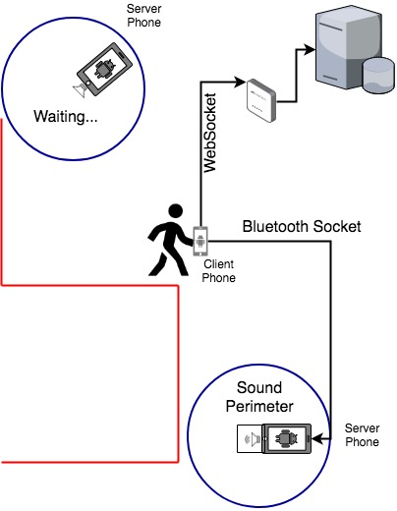
Sound Re-Calibration
Client Side Sound Re-Calibration Algorithm
Client gets initial adjacency list
Open socket with first adjacent phone
Socket open?
Server send sound
Not open?
Connect to next server in list
Server sound heard?
Yes?
Is client within perimeter?
No?
Move client to closest point on perimeter
Yes?
Reconnect to this server
No?
Iterate to next adjacent server phone/restart
SDMAY19-27

Slide 19
HoloLens Implementation

Slide 20
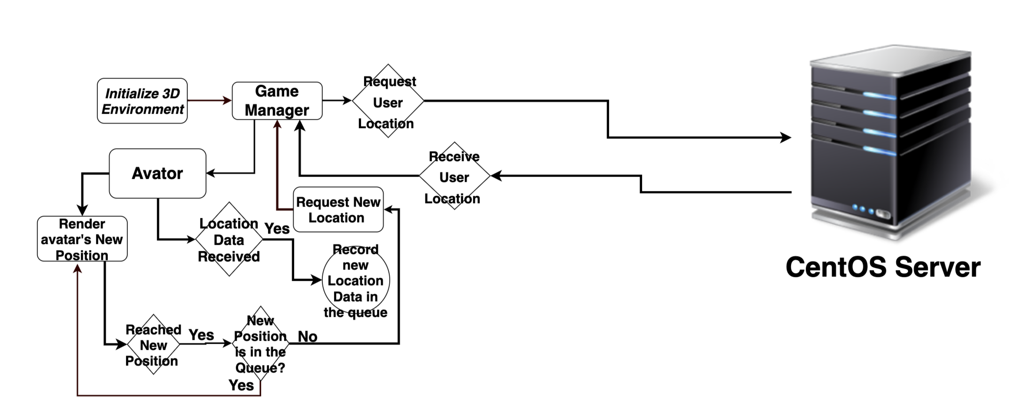

Slide 21
Testing

Slide 22
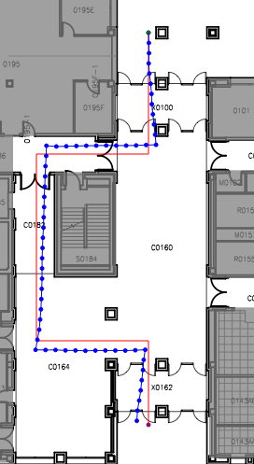
Interface Testing
Website:
Compared calculated path to actual path
True end location vs calculated end location
True turn location vs calculated turn location
Walk paths and verify data is correctly displayed
Hololens:
Similar to the website testing
True Path
Calculated Path
SDMAY19-27

Slide 23
Turn Path Accuracy
Turn Path
Average Drift: 0.462m
True Path
Calculated Path

Slide 24
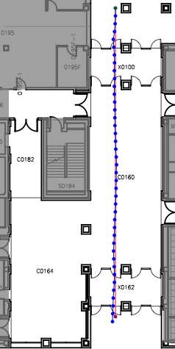
Straight Path Accuracy
Straight Path
Average Drift: 0.58m
True Path
Calculated Path

Slide 25
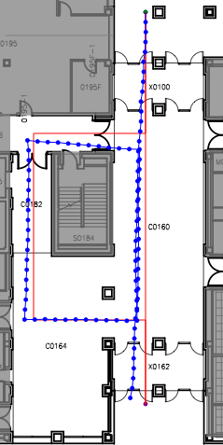
Loop Path Accuracy
Loop Path
Average Drift: 1.108m
True Path
Calculated Path

Slide 26
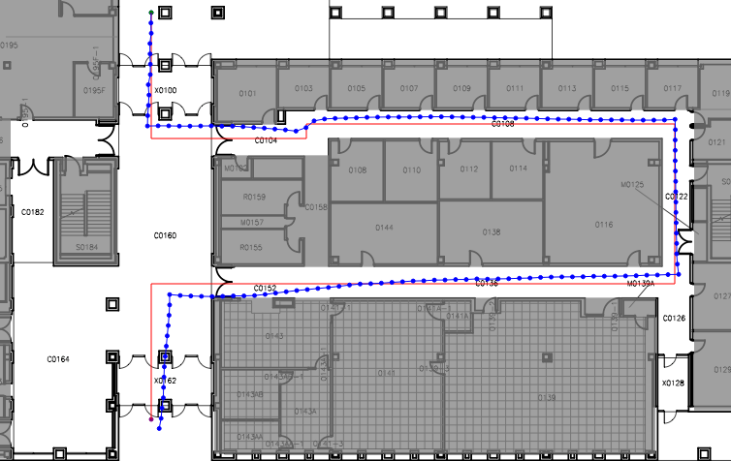
Long Path Accuracy
Long Path
Average Drift: 1.21m
True Path
Calculated Path

Slide 27
Prototype

Slide 28
Prototype Demo

Slide 29
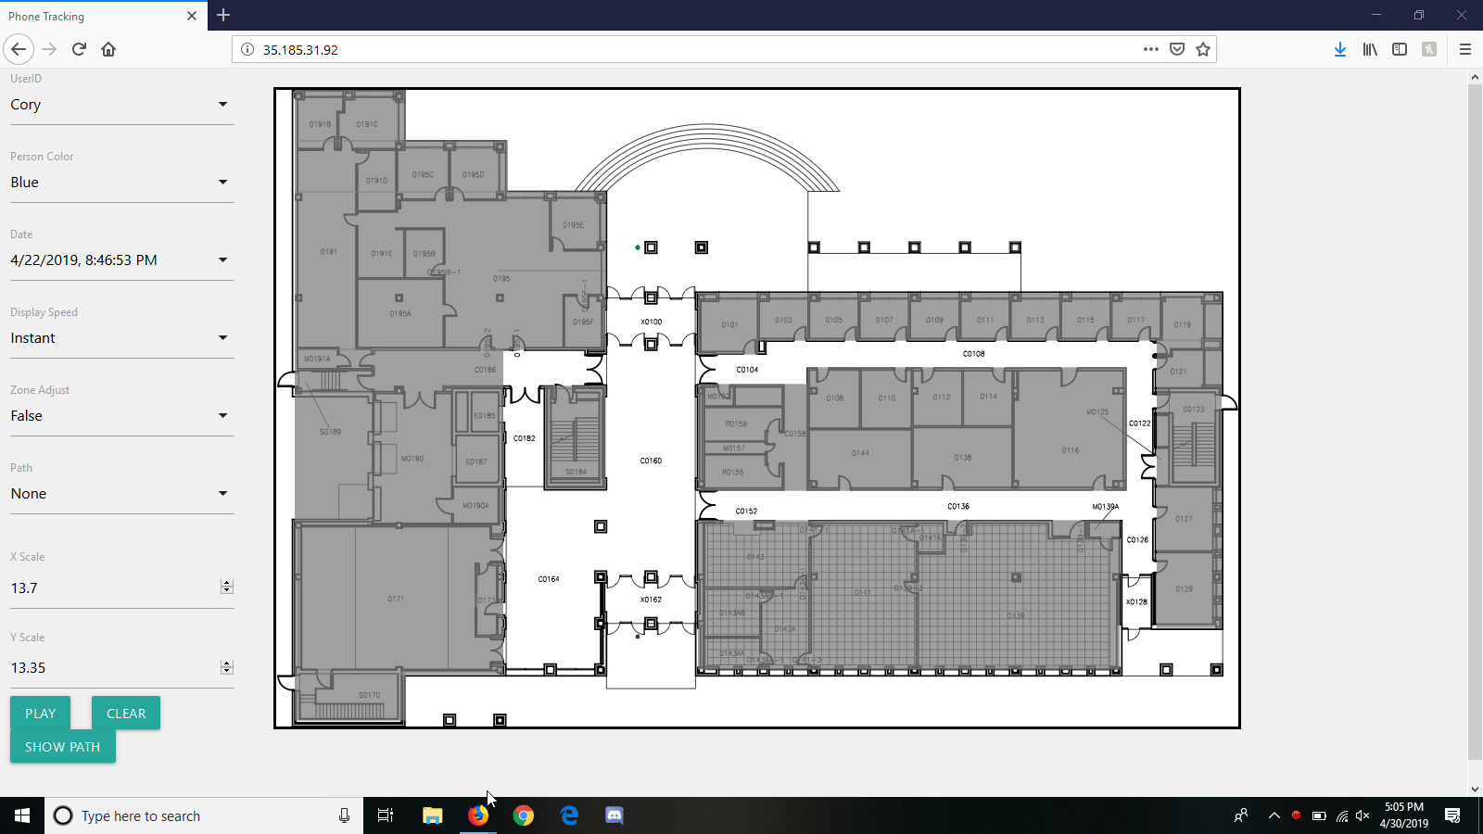
Prototype Demo

Slide 30
Prototype Demo
https://drive.google.com/file/d/1wBnc5b3UdBhAsLzBRnds6q6GgeyzSrgB/view?usp=sharing
SDMAY19-27

Slide 31
Conclusion

Slide 32
Accomplishments
Developed an Android application to use accelerometer and gyroscope to track a users steps and approximate their location, and send this information to a database
Created a server to handle, analyze, and present upon data from application
Made an extension for system that works with Microsoft Hololens to display data
SDMAY19-27

Slide 33
Future Work
Automatic time playback based on a given date-time
Data scrubber for daily playback
Full day of tracking and recording data
Recording accuracy and getting precise x, y scales for each user
Potential for machine learning integration
Using web workers or RPC to C / Java for Dijkstra’s Algorithm
Implementing Beacons
SDMAY19-27

Slide 34
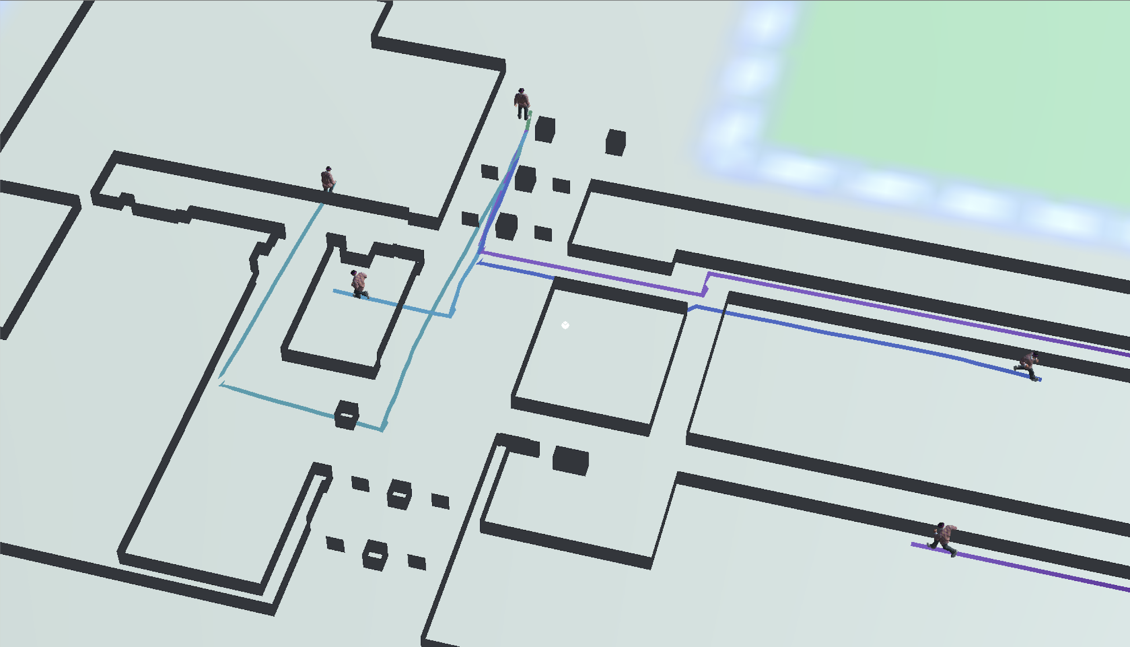
HoloLens Future Work
Currently implemented
SDMAY19-27

Slide 35
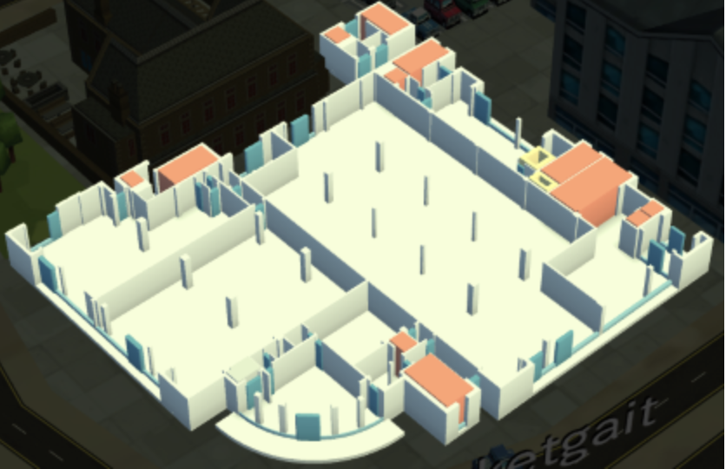
HoloLens Future Work
Use
WRLD sdk
QGIS
Unity
Unity UI Components
Software Used
WRLD sdk
QGIS
Unity
Unity UI Components
SDMAY19-27

Slide 36
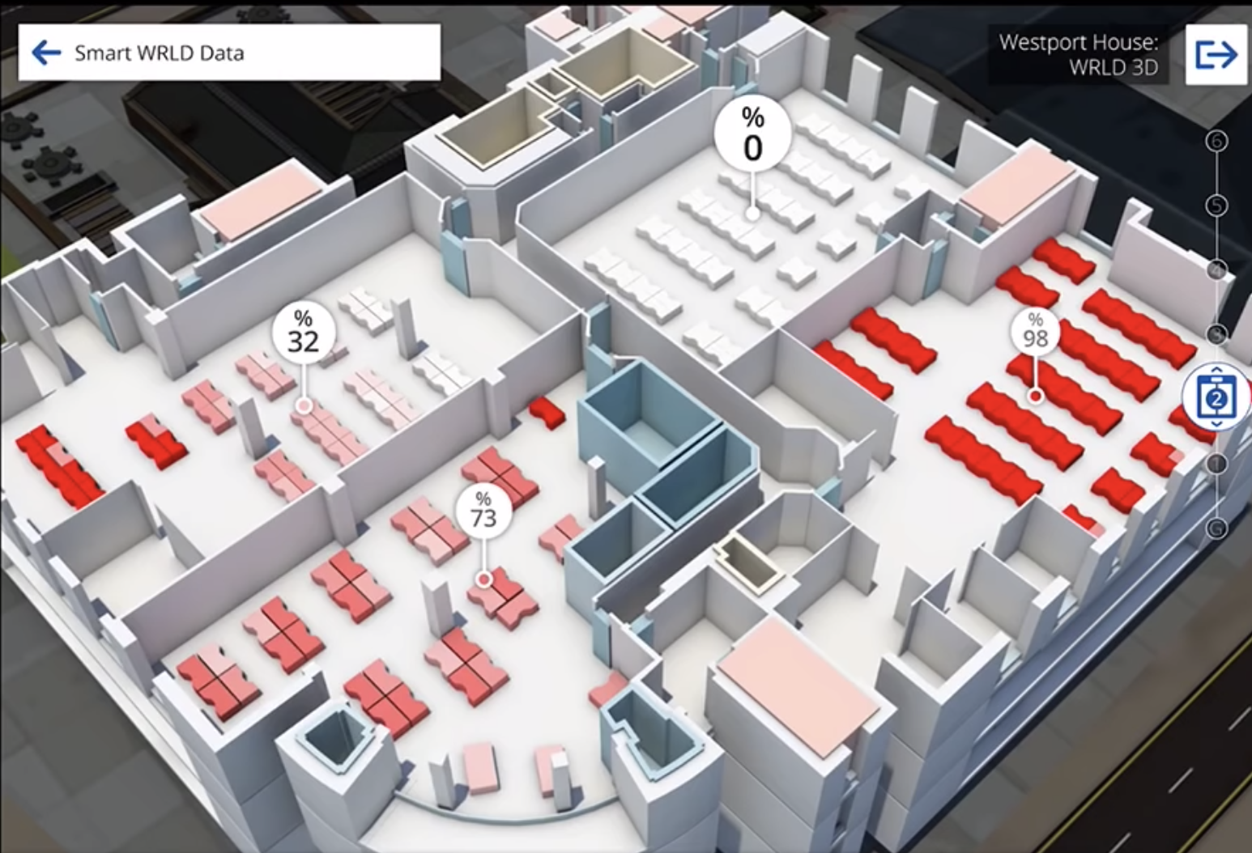
SDMAY19-27

Slide 37
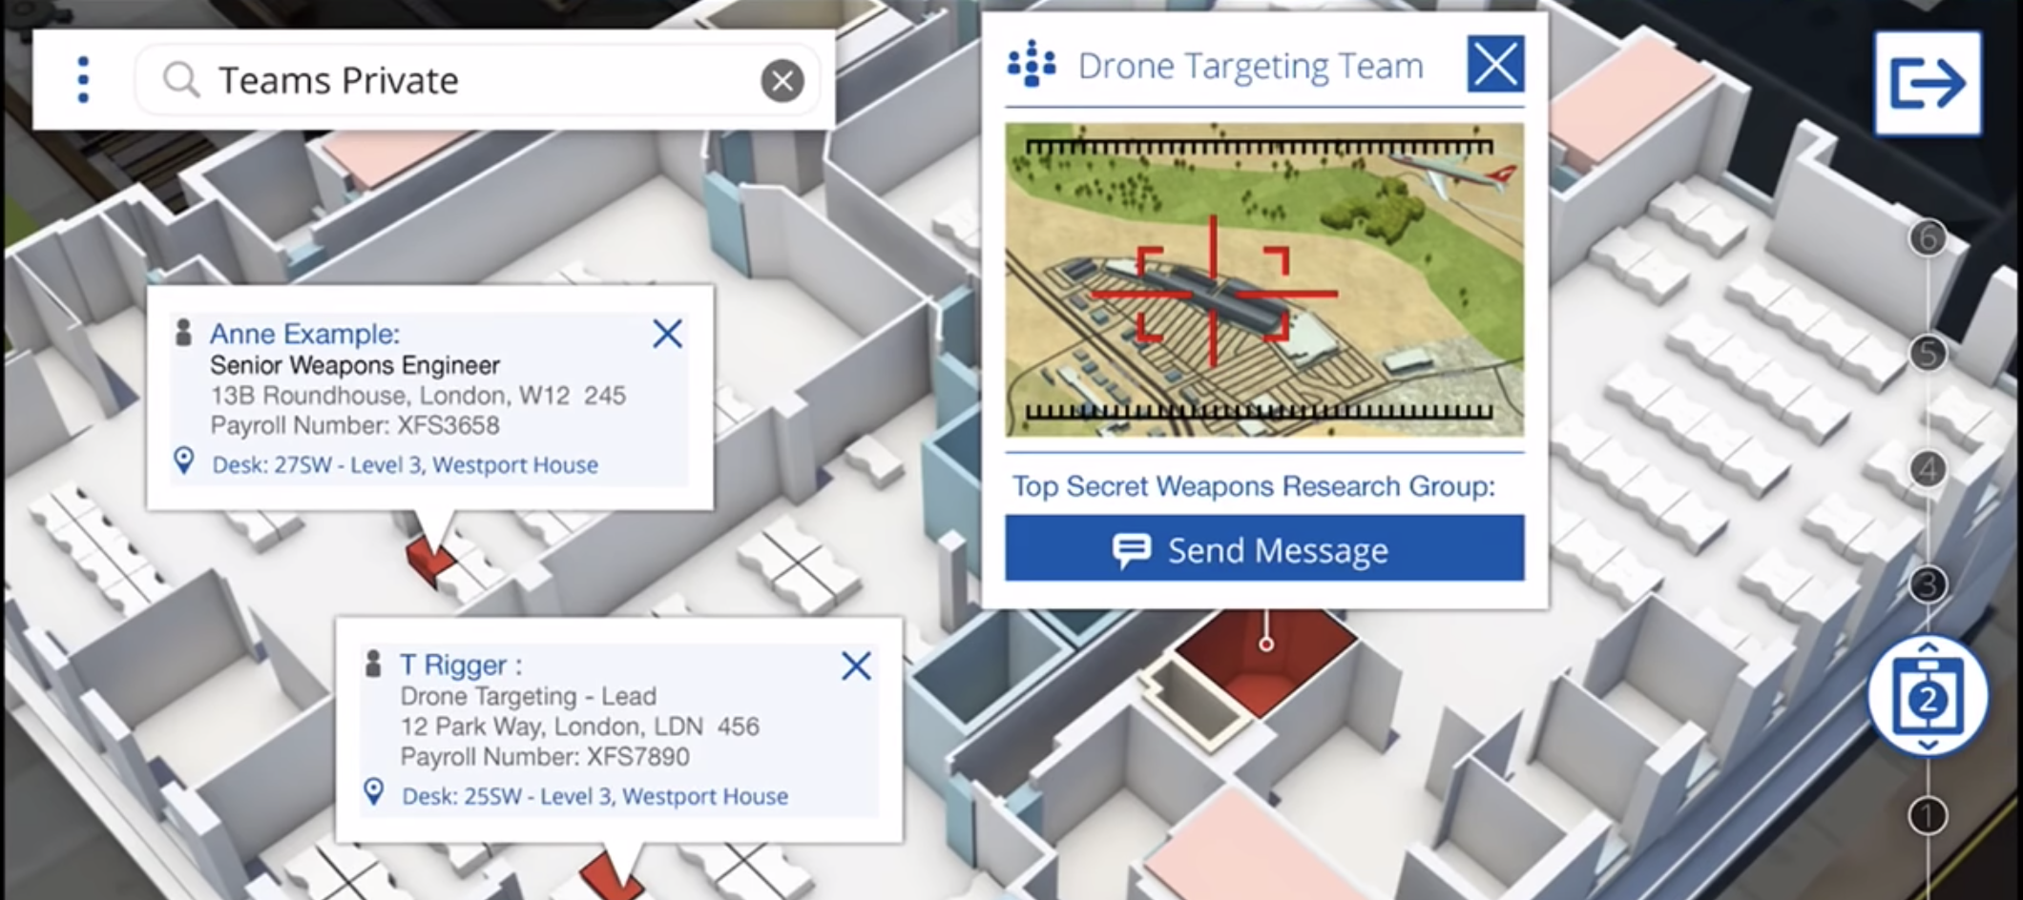

Slide 38
What We Learned
What approach of problem solving did we used?
Waterfall
Clear deliverable with specific milestones
Team Building
Delegation of work
Designating roles to capitalize on strengths
Multiple viewpoints
Asking for help when needed
Researching similar work to get ideas and improve solution
SDMAY19-27

Slide 39
THANK YOU!
ANY QUESTIONS?
sdmay19-27@iastate.edu
SDMAY19-27

Slide 40
Index

Slide 41
Front-End Implementation
CLIENT
SERVER

Slide 42
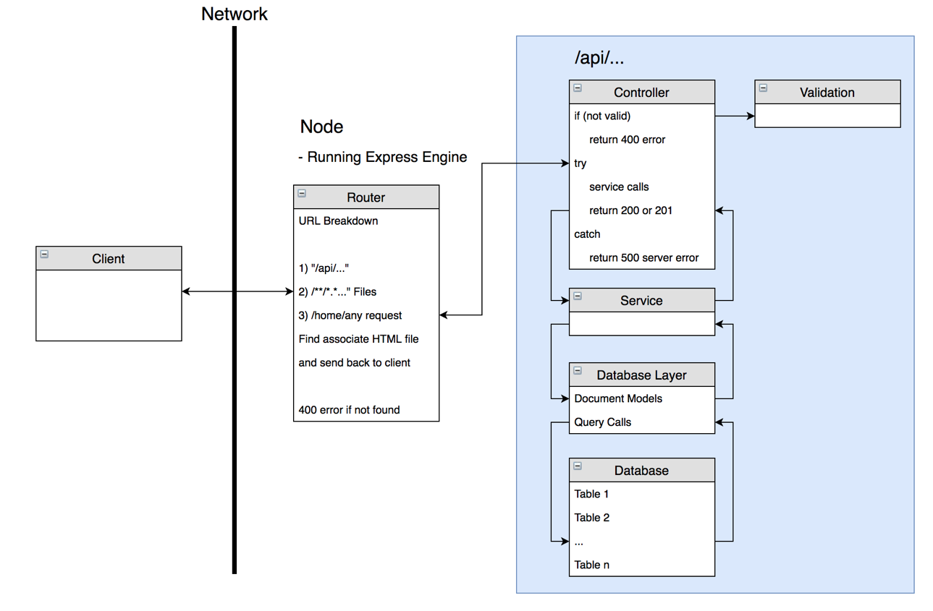
Back-End Implementation
CLIENT
SERVER

Slide 43
Gyroscope Implementation
Androids Gyroscope sensor gives you radians per second.
When gyroscope gets a new event
Add event value to current rotation
Degrees = rotation *180/PI
SDMAY19-27

Slide 44
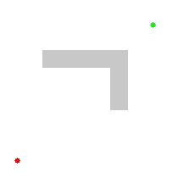
Dijkstra’s Algorithm

Slide 45
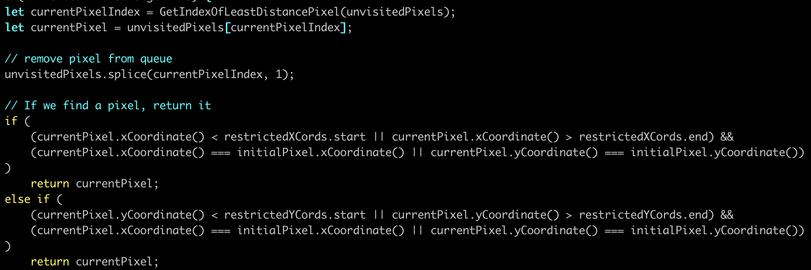
Dijkstra Algorithm

Slide 46
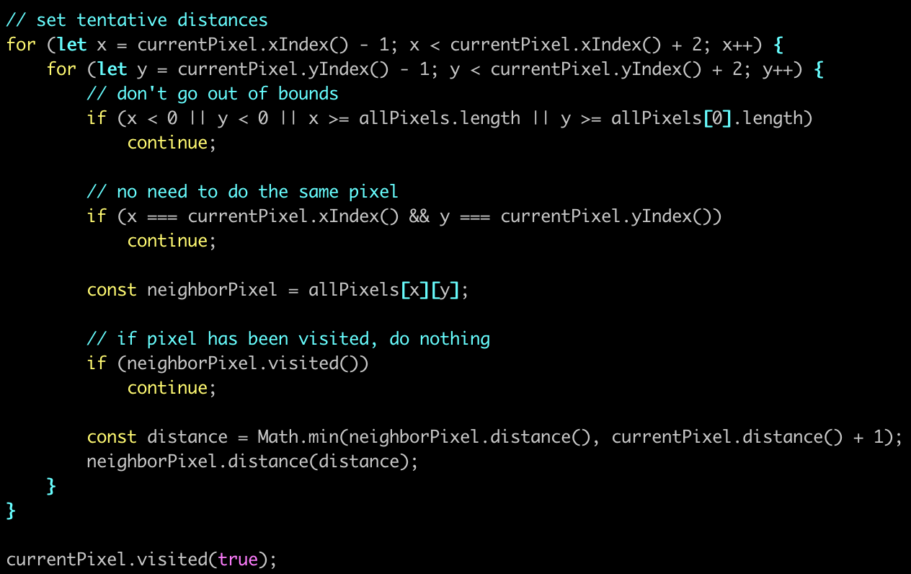
Dijkstra Algorithm (Continued)

